Slide 1
Chapter 7
Semi-supervised Deep Learning for Secure Internet of Things

Slide 2

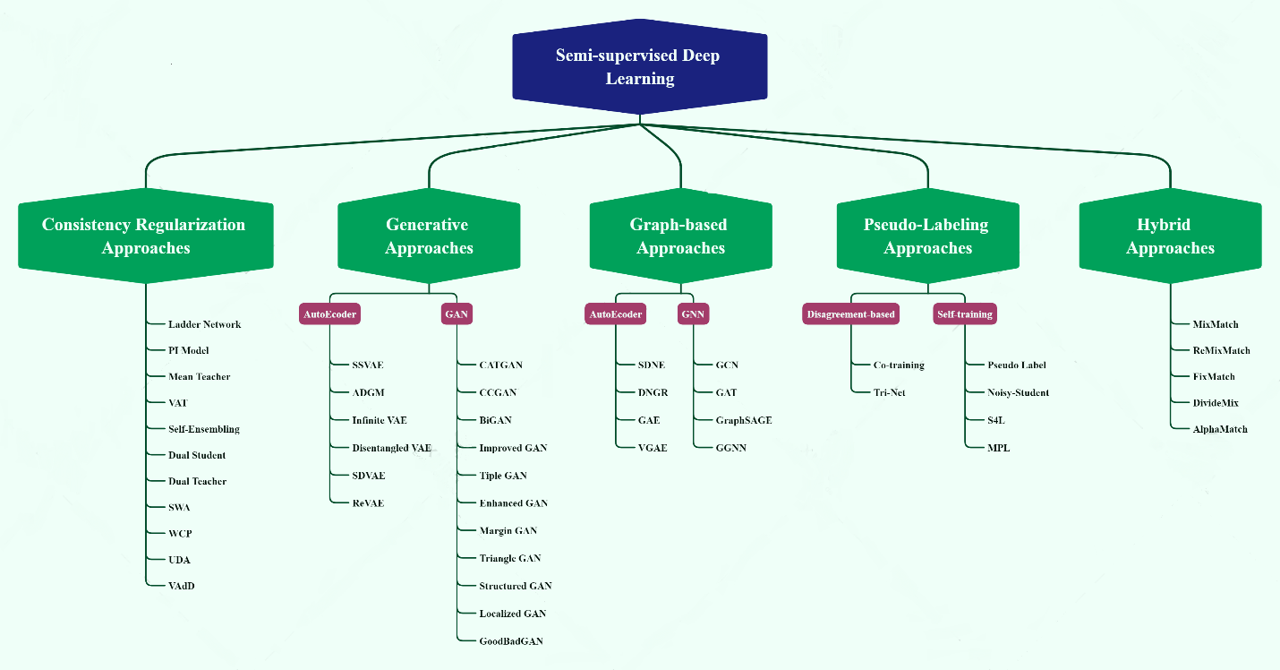
Background and Foundations

Slide 3
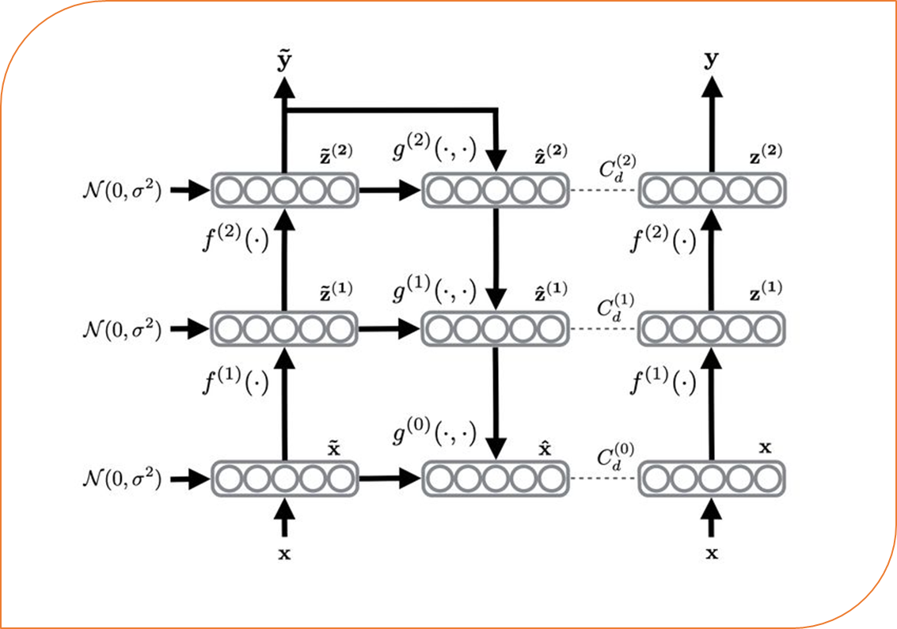
Consistency Regularization Approaches

Slide 4
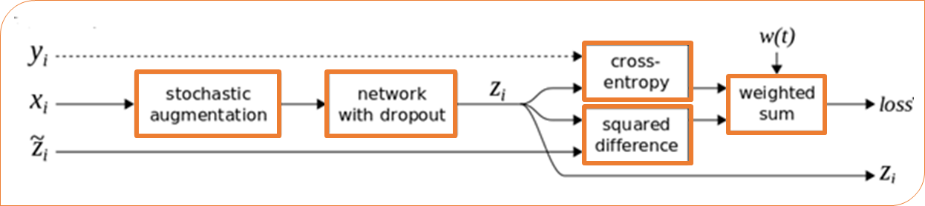
Consistency Regularization Approaches

Slide 5
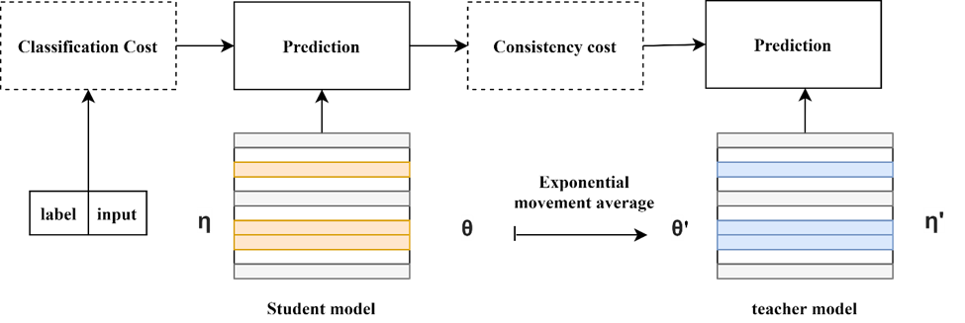
Consistency Regularization Approaches

Slide 6
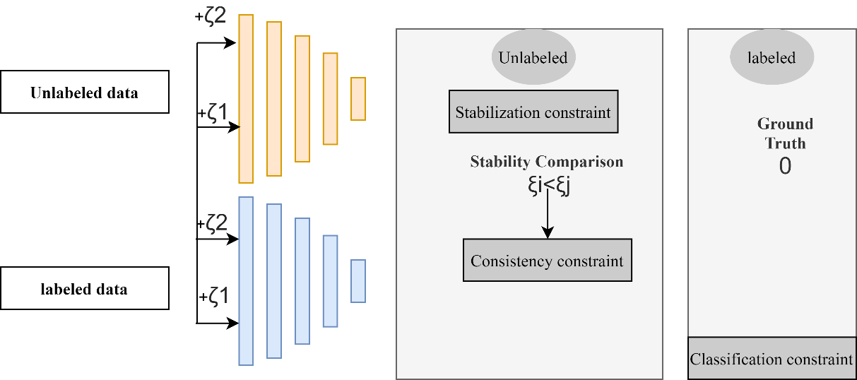
Consistency Regularization Approaches

Slide 7
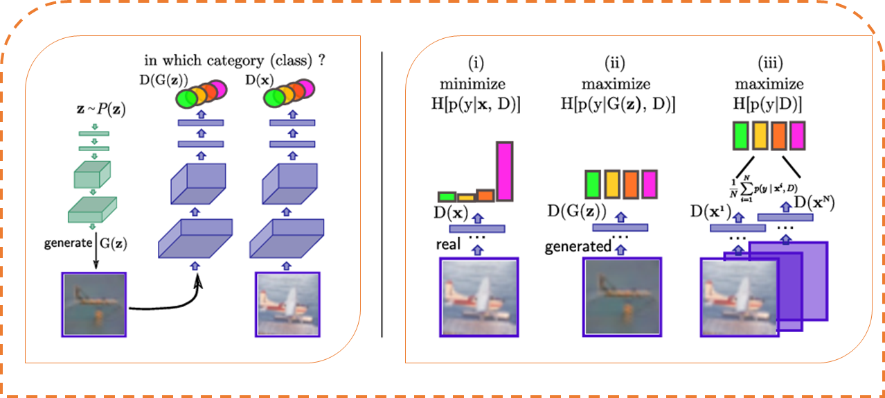
Semi-supervised Generative Approaches

Slide 8
Semi-supervised Autoencoder Approaches
Semi-supervised VAEs (SSVAEs)
Infinite VAE
Disentangled variational autoencoder

Slide 9
Semi-supervised Graph-Based Approaches
Baseline GNN
Graph Convolutional Network (GCN)
Graph Attention Network (GAT)

Slide 10
Pseudo-labeling Approaches
Disagreement-centered methods
Self-training methods

Slide 11

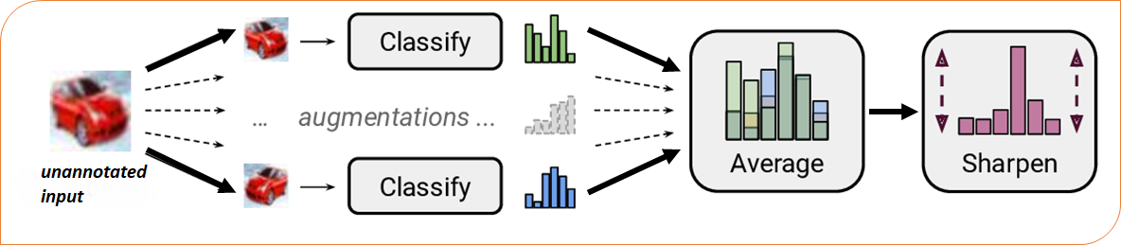
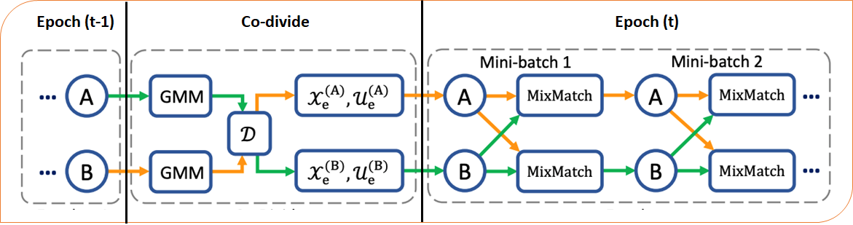
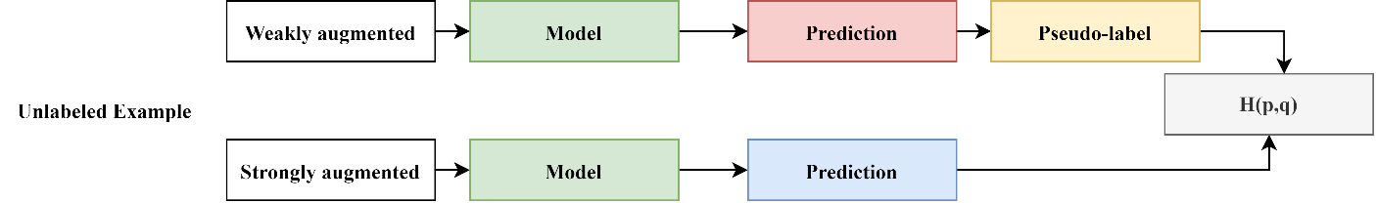
Hybrid Approaches
Interpolation Consistency Training
MixMatch
ReMixMatch
DivideMix
FixMatch

